Slide 1
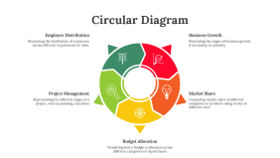
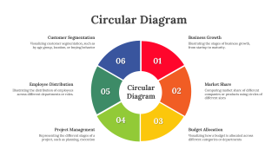
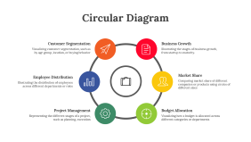
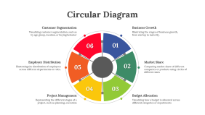
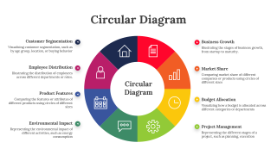
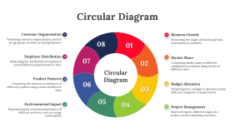
Circular Diagram

Slide 2
Circular Diagram
Customer Segmentation
Visualizing customer segmentation, such as by age group, location, or buying behavior
Business Growth
Illustrating the stages of business growth, from startup to maturity.
Employee Distribution
Illustrating the distribution of employees across different departments or roles
Market Share
Comparing market share of different companies or products using circles of different sizes
Project Management
Representing the different stages of a project, such as planning, execution
Budget Allocation
Visualizing how a budget is allocated across different categories or departments

Slide 3
Circular Diagram
Customer Segmentation
Visualizing customer segmentation, such as by age group, location, or buying behavior
Business Growth
Illustrating the stages of business growth, from startup to maturity.
08
01
Employee Distribution
Illustrating the distribution of employees across different departments or roles.
07
Market Share
Comparing market share of different companies or products using circles of different sizes
02
Circular Diagram
Product Features
Comparing the features or attributes of different products using circles of different sizes
06
Budget Allocation
Visualizing how a budget is allocated across different categories or departments
03
05
Environmental Impact
Representing the environmental impact of different activities, such as energy consumption
04
Project Management
Representing the different stages of a project, such as planning, execution

Slide 4
Circular Diagram
Customer Segmentation
Visualizing customer segmentation, such as by age group, location, or buying behavior
Business Growth
Illustrating the stages of business growth, from startup to maturity.
06
01
Employee Distribution
Illustrating the distribution of employees across different departments or roles.
02
Market Share
Comparing market share of different companies or products using circles of different sizes
05
04
03
Project Management
Representing the different stages of a project, such as planning, execution
Budget Allocation
Visualizing how a budget is allocated across different categories or departments

Slide 5
Circular Diagram
Employee Distribution
Illustrating the distribution of employees across different departments or roles.
Business Growth
Illustrating the stages of business growth, from startup to maturity.
Project Management
Representing the different stages of a project, such as planning, execution
Market Share
Comparing market share of different companies or products using circles of different sizes
Budget Allocation
Visualizing how a budget is allocated across different categories or departments

Slide 6
Circular Diagram
Customer Segmentation
Visualizing customer segmentation, such as by age group, location, or buying behavior
Business Growth
Illustrating the stages of business growth, from startup to maturity.
Employee Distribution
Illustrating the distribution of employees across different departments or roles.
Market Share
Comparing market share of different companies or products using circles of different sizes
Circular Diagram
Product Features
Comparing the features or attributes of different products using circles of different sizes
Budget Allocation
Visualizing how a budget is allocated across different categories or departments
Environmental Impact
Representing the environmental impact of different activities, such as energy consumption
Project Management
Representing the different stages of a project, such as planning, execution

Slide 7
Circular Diagram
Customer Segmentation
Visualizing customer segmentation, such as by age group, location, or buying behavior
Business Growth
Illustrating the stages of business growth, from startup to maturity.
06
01
Employee Distribution
Illustrating the distribution of employees across different departments or roles.
Circular Diagram
02
Market Share
Comparing market share of different companies or products using circles of different sizes
05
04
03
Project Management
Representing the different stages of a project, such as planning, execution
Budget Allocation
Visualizing how a budget is allocated across different categories or departments

Slide 8
Icons

Slide 9
Icons

Slide 10
How To Edit Shapes
You can add and edit some shapes to your presentation to present your data in a visual way.
Choose your favourite infographic and insert it in your presentation using Ctrl C + Ctrl V or Cmd C + Cmd V in Mac.
Select one of the parts and ungroup it by right-clicking and choosing “Ungroup”.
Change the color by clicking on the paint bucket.
Then resize the element by clicking and dragging one of the square-shaped points of its bounding box (the cursor should look like a double-headed arrow). Remember to hold Shift while dragging to keep the proportions.
Group the elements again by selecting them, right-clicking and choosing “Group”.
Repeat the steps above with the other parts and when you’re done editing, copy the end result and paste it into your presentation.
Remember to choose the “Keep source formatting” option so that it keeps the design. For more info, please visit Slideegg (Tips & Tricks).

Slide 11
Terms Of Use (Free Users)
If you are a free subscriber, you should credit SlideEgg by keeping the “Thank You” slide.
Kindly refer to the following slide for the Terms of Use for premium users.
You can:
Customize or edit this template
Use this template for both business and personal endeavors.
You can not:
Sell, rent, or second-license SlideEgg content or its altered version. Promulgate, unless explicitly permitted, SlideEgg content, by SlideEgg.
Incorporate SlideEgg content in any database or file online or offline.
Obtain SlideEgg content’s copyright.
Kindly refer to our Tutorial page or FAQ for advanced slide modification guidelines.

Slide 12
Terms Of Use (Premium Users)
Being a premium subscriber, you have the privilege of using this PPT template
without giving attribution to SlideEgg or keeping the “Thank You” slide.
You can:
Customize or edit this template.
Use this template for both business and personal endeavors.
Circulate or share the editable format of this template with anyone you want.
You can not:
Sell, rent or second-license SlideEgg content or the altered version of it. Promulgate or include the templates in any other services database
that performs as distribution or resale platform, unless explicitly permitted, by SlideEgg.
Incorporate the elements used in SlideEgg’s templates separately.
Obtain SlideEgg’s copyright for the elements used in this template as a logo or trademark.
Kindly refer to our Tutorial page or FAQ for advanced slide modification guidelines.

Slide 13





Thank You!
We respect your valuable time with SlideEgg!
If you have any questions, please reach us
Do you have a design request, please visit our redesign page.
CREDIT: SlideEgg created this PowerPoint template.
Let this slide be kept for attribution.
www.slideegg.com

